Slide 1
Makeup Types

Slide 2
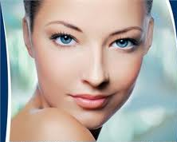

Slide 3
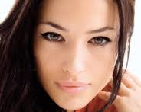

Slide 4
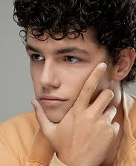

Slide 5
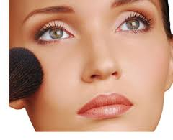

Slide 6
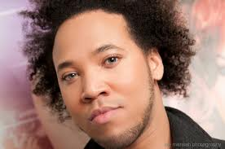

Slide 7
1. CORRECTIVE

Slide 8
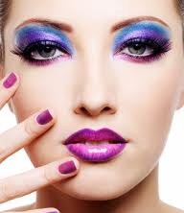

Slide 9
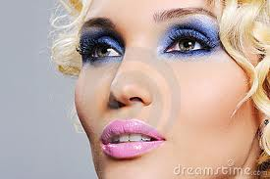

Slide 10
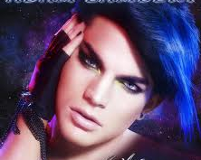

Slide 11
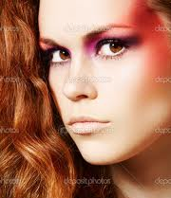

Slide 12
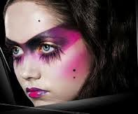

Slide 13
2. GLAMOR

Slide 14
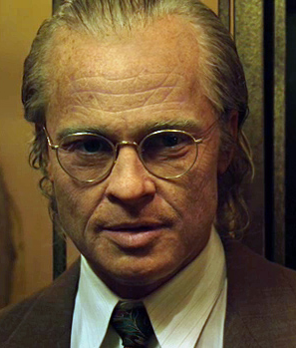

Slide 15
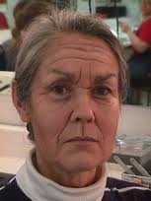

Slide 16
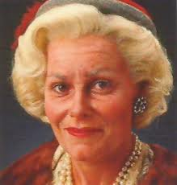

Slide 17
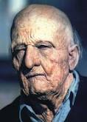

Slide 18
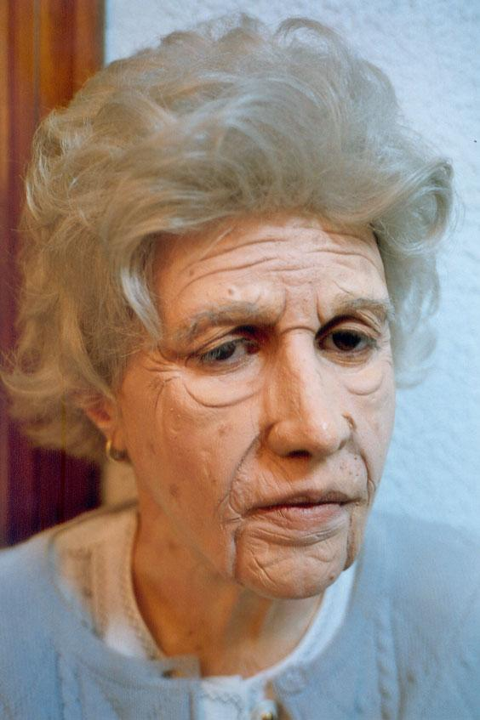

Slide 19
3. OLD AGE

Slide 20
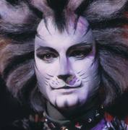

Slide 21
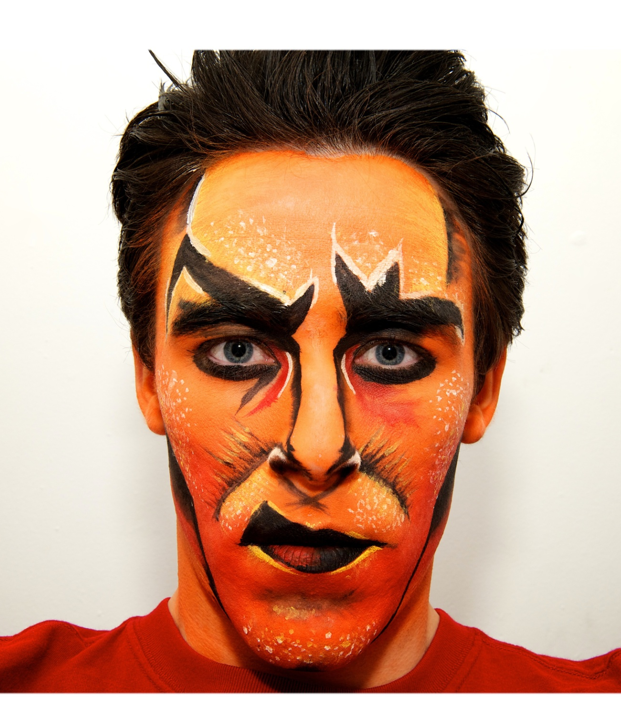

Slide 22
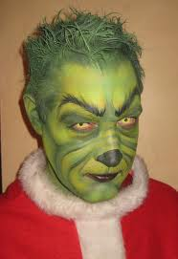

Slide 23
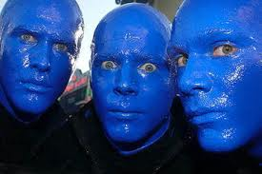

Slide 24
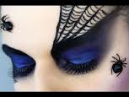

Slide 25
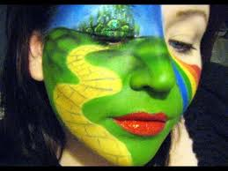

Slide 26
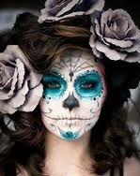

Slide 27
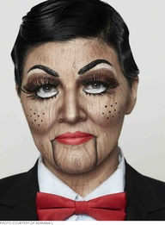

Slide 28
4. Stylized/Fantasy

Slide 29
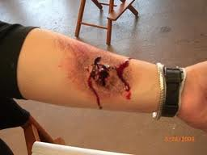

Slide 30
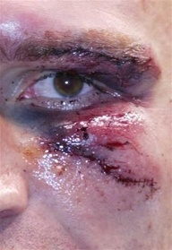

Slide 31
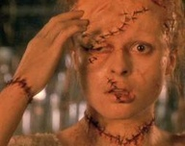

Slide 32
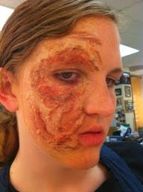

Slide 33
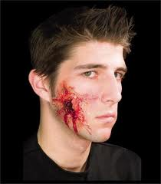

Slide 34
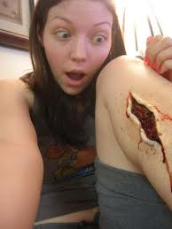

Slide 35
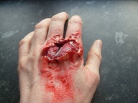

Slide 36
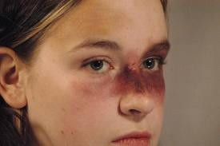

Slide 37
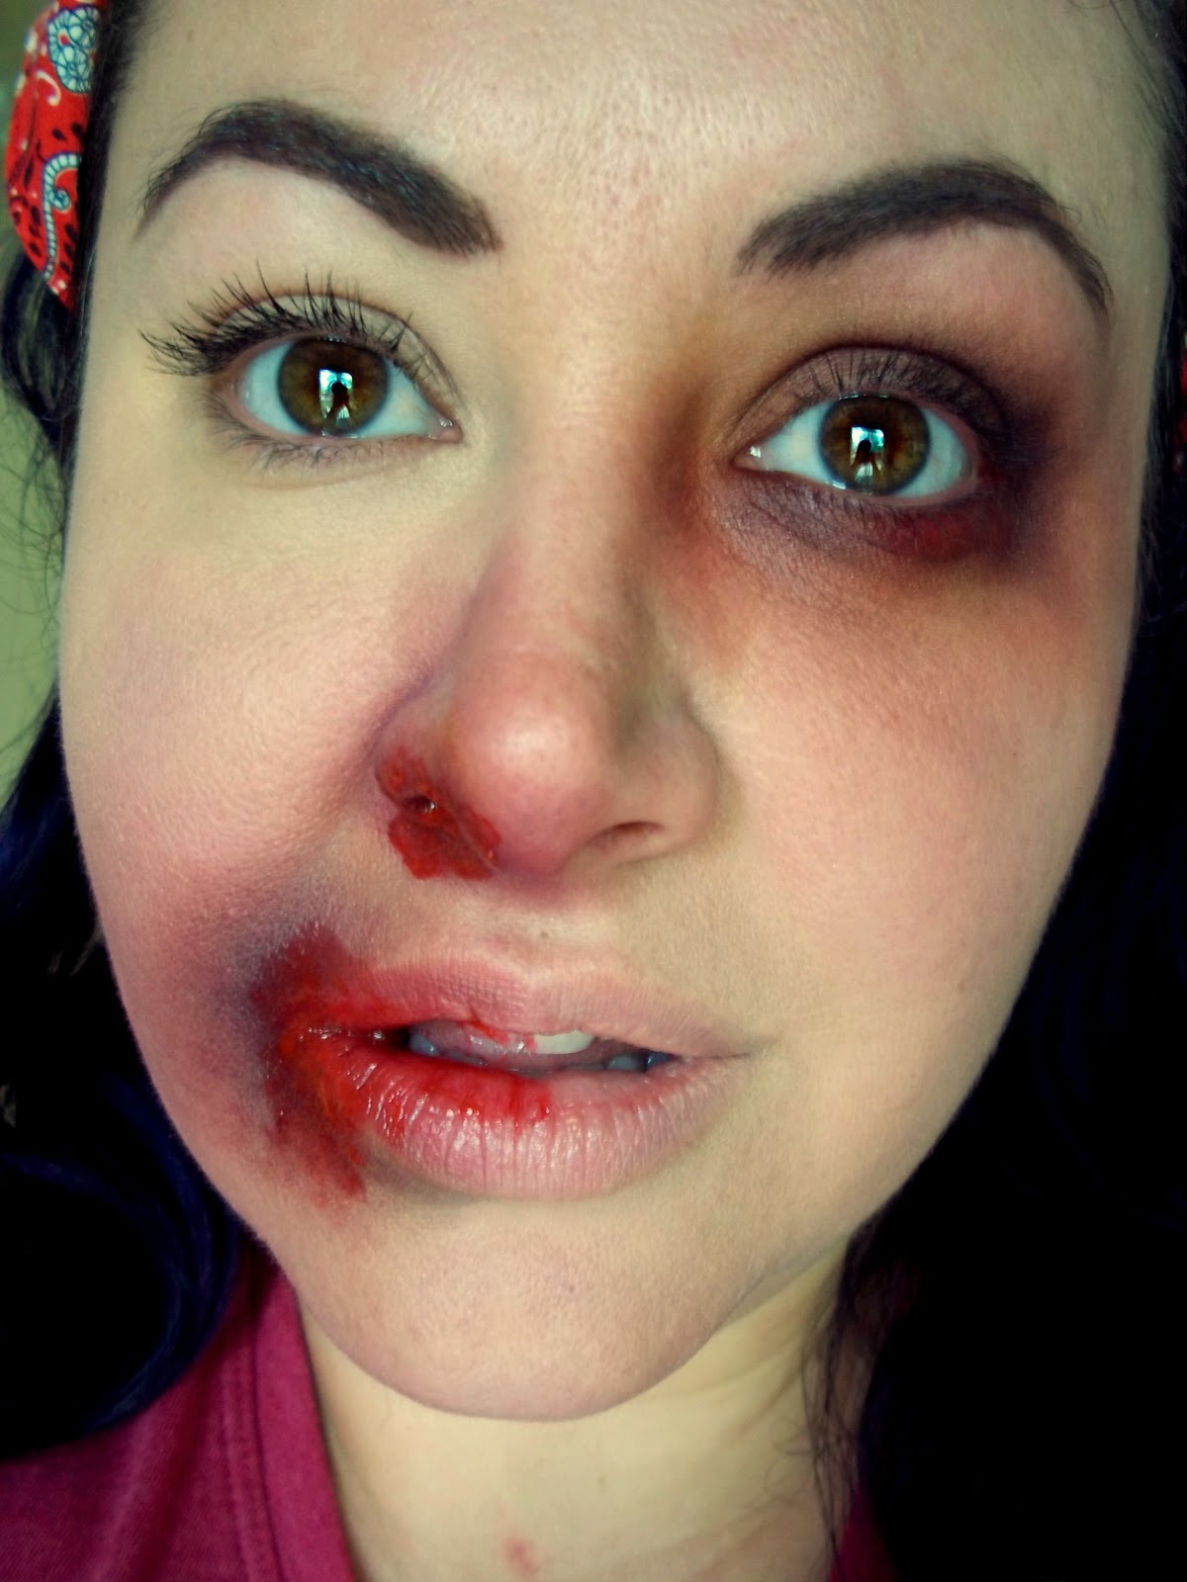

Slide 38
5. Grossies/Gories

Slide 39
Day 2:

Slide 40
Review – 5 categories of stage makeup
Corrective
Glamour
Old Age
Stylized/Fantasy
Grossies/Gories

Slide 41
Facial Features
Forehead
Nose
Cheeks
Eyes
Lips
Chin
Jowls
Neck
Ears
Skin

Slide 42
6 basic face shapes:

Slide 43
What’s your face shape?

Slide 44
Stage Makeup Kit
Tools
Stage makeup “musts”
Sponges
Brushes
Powder Puff
Baby wipes
Towel
Qtips
Base (Foundation, Cake Makeup, or Cream)
Cream Contouring Colors
Rouge (blush)
Setting Powder
Eye Liners
Lip Liners
Eye Colors (Creams as well as Powders)
Lipsticks or Lip Colors
Waterproof Mascara

Slide 45
Who is responsible for stage makeup?
The actor!!!!!

Slide 46
Stage Makeup Assignment #1
Makeup Morgue.
Your face.

